Slide 1
Student Details
NAME: RAHUL SAMBATURU
CLG Reference ID: AP22110011279
INSTITUTE: S.R.M. UNIVERSITY ANDHRA PRADESH
IBM EMAIL ID: rahul_sambaturu@srmap.edu.in
DOMAIN: cyber security
Date of joining :03-06-2024
Date of ending :25-07-2024

Slide 2

PROJECT TITLE:Hiding text in an image using steganography
PROBLEM STATEMENT: Steganography in cybersecurity involves concealing text within an image, making the information invisible to casual observers. This technique is used to covertly transmit data, protecting it from unauthorized access or detection
Image steganography: Image steganography hides information within an image by subtly altering pixel values. This technique ensures secret data transmission without noticeable changes to the image, enhancing security and privacy in communication

Slide 3

AGENDA
Our steganography project focuses on achieving secure data transmission by embedding and extracting hidden messages in digital images using the Least Significant Bit (LSB) method and XOR encryption. The main goals include ensuring the invisibility and security of the concealed messages, streamlining implementation with standard image formats, and tailoring algorithms and user interfaces for improved performance and usability. The project highlights the importance of hiding messages without detectable changes, employing XOR encryption for added data security, and offering practical code examples to illustrate the embedding and extraction processes. Detailed modeling steps and practical implementation underline the project's comprehensive strategy for secure communication.

Slide 4

PROJECT OVERVIEW
Objectives: Concealing and retrieving hidden messages in digital images through the Least Significant Bit (LSB) method combined with XOR encryption.
Methodology:
LSB Technique: Embedding secret data by altering the least significant bits of pixel values, ensuring the host image remains visually unchanged.
XOR Encryption: Increasing security by encrypting data prior to embedding, making it challenging for unauthorized parties to decode the concealed message
Applications:
Protecting personal privacy and securely storing data.
Facilitating covert communication in restrictive settings.
Ensuring the secure transfer of sensitive information.
Maintaining confidential communication channels
Preserving anonymity and safeguarding sources

Slide 5
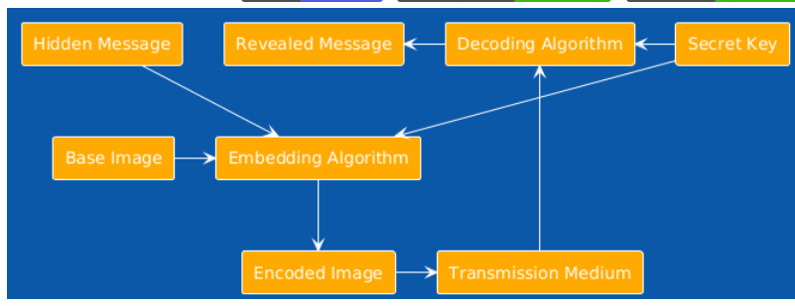
Project overview

Slide 6

WHO ARE THE END USERS of this project?
Businesses: Protect intellectual property and internal communications.
Cybersecurity Experts: Safeguard data and communications from cyber threats.
Government Bodies: Ensure secure and confidential information transmission.
Reporters: Protect source identities and secure their communications.
Activists: Maintain secure communication in areas with limited speech freedom.
Businesses: Protect intellectual property and internal communications.
Law Enforcement: Securely transmit sensitive investigative information.
Individuals: Preserve personal privacy and secure data storage.
Military: Enable covert and secure classified communications.
Healthcare Providers: Secure patient data and confidential communications.
Financial Sector: Safeguard the transmission of financial data and communications.

Slide 7
YOUR SOLUTION AND ITS VALUE PROPOSITION
Solution:
Our steganography project offers a secure way to hide and retrieve messages within digital images. By using the Least Significant Bit (LSB) method and XOR encryption, we keep hidden data invisible and protected from unauthorized access.
Key Features:
LSB Method: Hides secret data by changing the least significant bits of pixel values, keeping the host image looking the same.
XOR Encryption: Encrypts data before hiding it to boost security, making it hard for unauthorized users to uncover the hidden messages.
User-Friendly Implementation: Provides an easy-to-use interface, works with common image formats, and includes customizable algorithms to enhance security and performance
Value Proposition:
Increased Protection: Combines encryption and hiding techniques to minimize the risk of data interception.
Secure Information Transfer: Ensures the safe exchange of sensitive data, perfect for journalists and activists.
Personal Data Privacy: Protects personal information from unauthorized access.
Intellectual Property Security: Embeds copyright details to prevent misuse.
Stealth Communication: Facilitates discreet communication in sensitive contexts.
Broad Applicability: Suitable for multiple industries and adaptable to various security requirements.

Slide 8
How did you customize the project and make it your own
Strong Encryption: Utilizes XOR-based encryption with a password, ensuring embedded messages are secure and accessible only with the correct key.
Improved Image Embedding: Uses the Least Significant Bit (LSB) method for accurate insertion and extraction of encrypted messages, bolstering data security.
Better User Interface: Features simple prompts for inputting the image path, password, and message, along with user feedback on successful operations and automatic display of the encrypted image.
Enhanced Performance:Optimized to maintain image quality and protect the hidden message from alterations during image editing.
Versatile Functionality:Supports various image formats and password complexities to meet diverse user requirements and security levels.
Effective Error Management : Includes extensive error handling to address incorrect inputs or operation failures, improving reliability and user confidence.

Slide 9
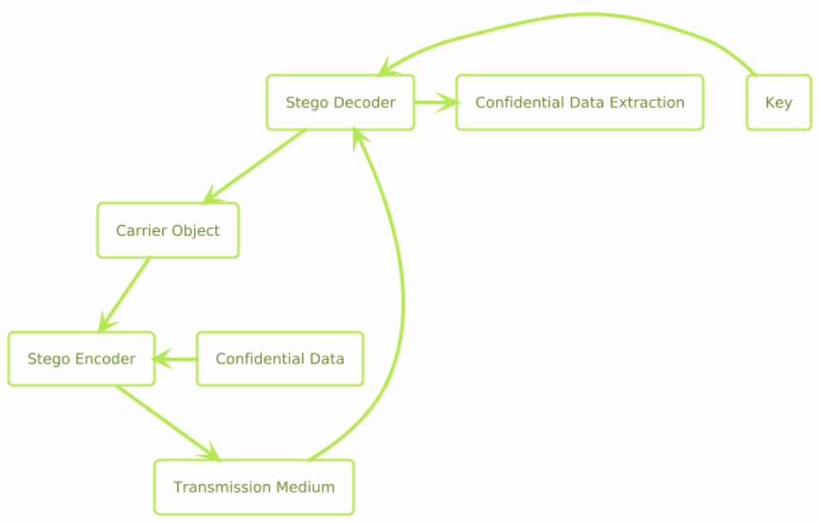
MODELLING
Input Handling:
Users input the path to the image file, enter a passcode, and type the text they wish to conceal.
Encryption Process:
Converts the input text into a sequence of ASCII values.
Encrypts these ASCII values by performing an XOR operation with characters from the passcode.
Embedding Process:
Embeds the encrypted text into the image using the Least Significant Bit (LSB) technique.
Processes the image pixels across all color channels (Red, Green, Blue) to embed the data.
Output Handling:
Saves the image containing the embedded data as a new file.
Displays a confirmation message to the user and automatically opens the saved image for review.
Extraction Process:
User provides the passcode to retrieve the hidden text.
Extracts the embedded text from the image and decrypts it using the XOR method with the same passcode.

Slide 10


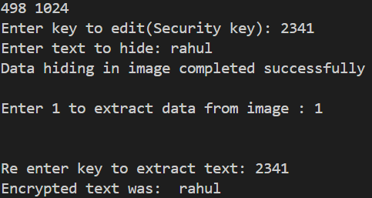
Results
Normal Image
Encrypted Image

Slide 11
links
Project links : https://github.com/Rahulsambaturu/cyber_security-internship (press ctrl+left click to open the links )
IBM SKILL BUILD EMAIL ID: rahul_sambaturu@srmap.edu.in

